Slide 1
Focus On
Self-Care
College Prep
Mr. Gordon
jgordon@bisdtx.org

Slide 2
Upcoming Events
hi

Slide 3
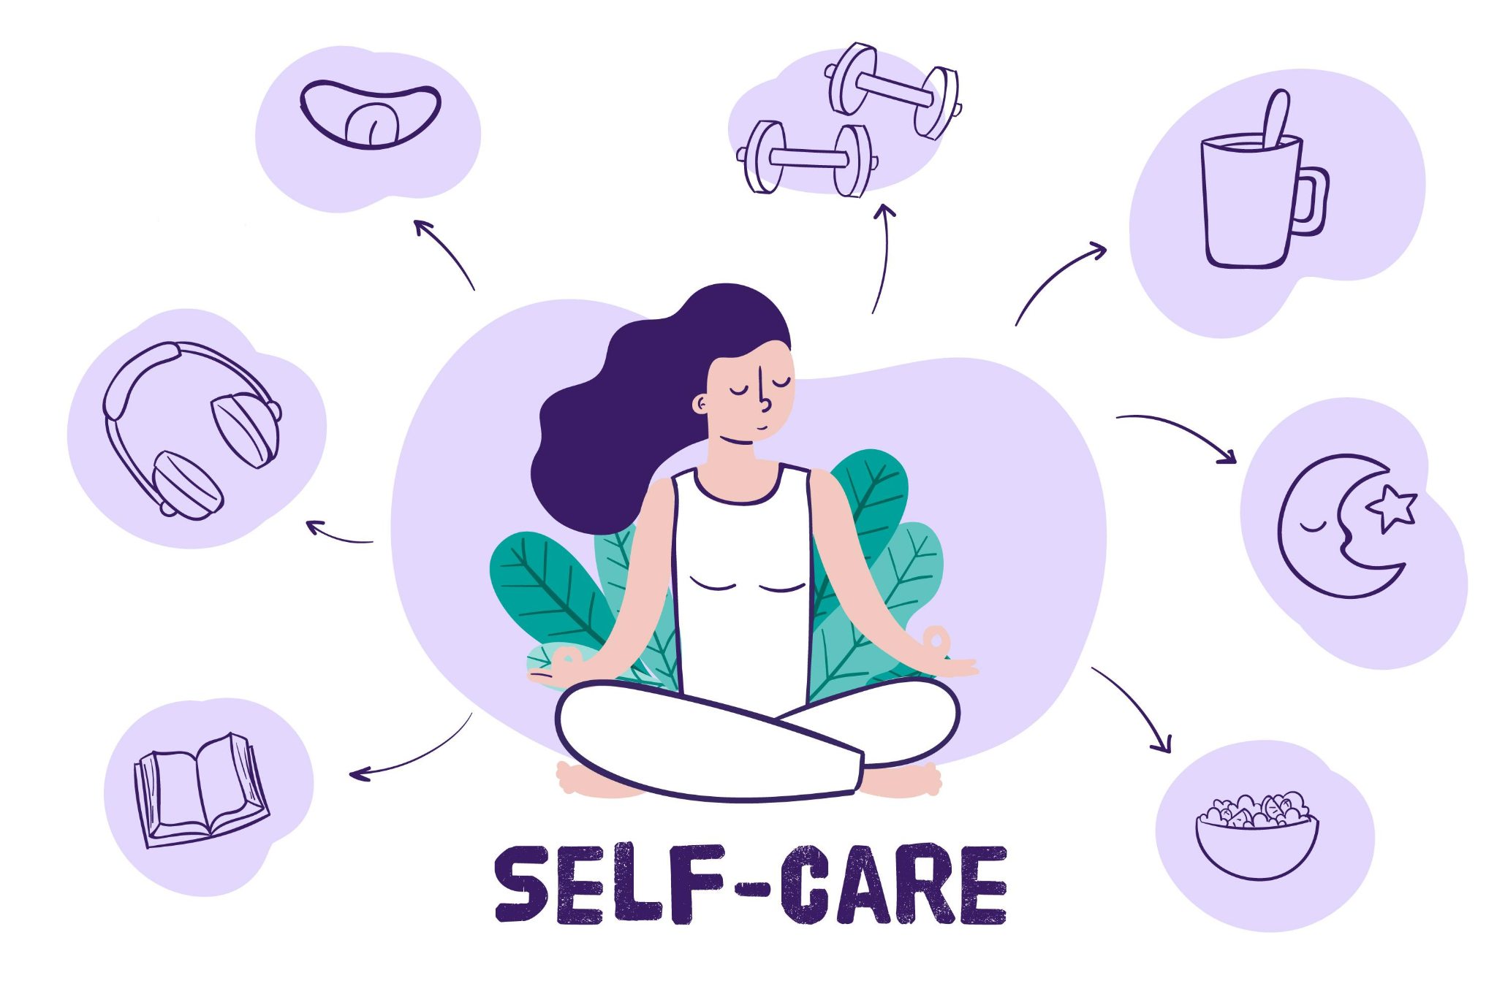
Self-Care
Sometimes it’s good to take a break and relax.
Doing this prepares us for the day, and is good for our
mental and emotional health.
This is especially true during
Finals Week!
hi

Slide 4
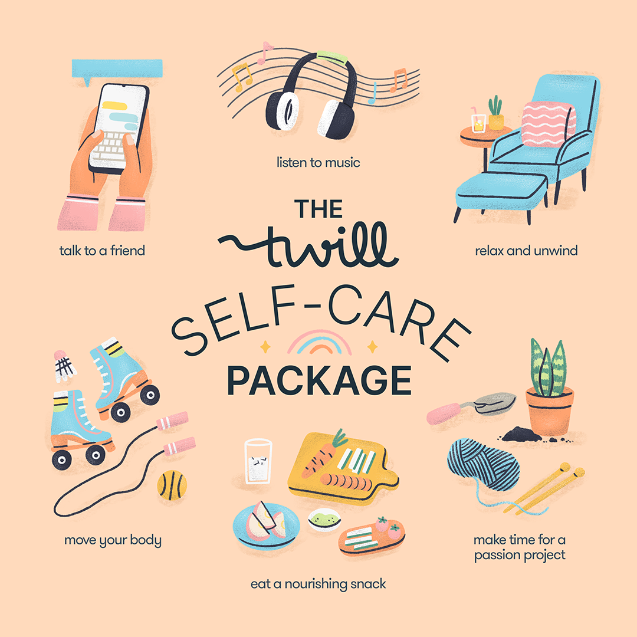
Self-Care
This Week
If you already have a self-care habit, do it.
If not, try one of the following:
Get in nature
Listen to music
Talk to a friend
Read a book
Watch a movie
Exercise
hi

Slide 5
Today’s College Prep Assignment
In the comments section of today’s College Prep,
answer the following question:
What do you do to relieve stress?
hi

